Slide 1
Chapter 2: Relational Model

Slide 2
Chapter 2: Relational Model
Structure of Relational Databases
Fundamental Relational-Algebra-Operations
Additional Relational-Algebra-Operations
Extended Relational-Algebra-Operations
Null Values
Modification of the Database

Slide 3

Example of a Relation

Slide 4
Basic Structure
Formally, given sets D₁, D₂, …. D_{n} a relation r is a subset of
D₁ x D₂ x … x D_{n}
Thus, a relation is a set of n-tuples (a₁, a₂, …, a_{n}) where each a_{i} ∈ D_{i}
Example: If
customer_name = {Jones, Smith, Curry, Lindsay}
customer_street = {Main, North, Park}
customer_city = {Harrison, Rye, Pittsfield}
Then r = { (Jones, Main, Harrison),
(Smith, North, Rye),
(Curry, North, Rye),
(Lindsay, Park, Pittsfield) }
is a relation over
customer_name x customer_street x customer_city

Slide 5
Attribute Types
Each attribute of a relation has a name
The set of allowed values for each attribute is called the domain of the attribute
Attribute values are (normally) required to be atomic; that is, indivisible
  Note: multivalued attribute values are not atomic
  Note: composite attribute values are not atomic
The special value null is a member of every domain
The null value causes complications in the definition of many operations
  We shall ignore the effect of null values in our main presentation and consider their effect later

Slide 6
Relation Schema
A₁, A₂, …, A_{n} are attributes
R = (A₁, A₂, …, A_{n} ) is a relation schema
Example:
Customer_schema = (customer_name, customer_street, customer_city)
r(R) is a relation on the relation schema R
Example:
customer (Customer_schema)

Slide 7
Relation Instance
The current values (relation instance) of a relation are specified by a table
An element t of r is a tuple, represented by a row in a table
attributes
(or columns)
customer_name
customer_street
customer_city
Jones
Smith
Curry
Lindsay
Main
North
North
Park
Harrison
Rye
Rye
Pittsfield
tuples
(or rows)
customer

Slide 8
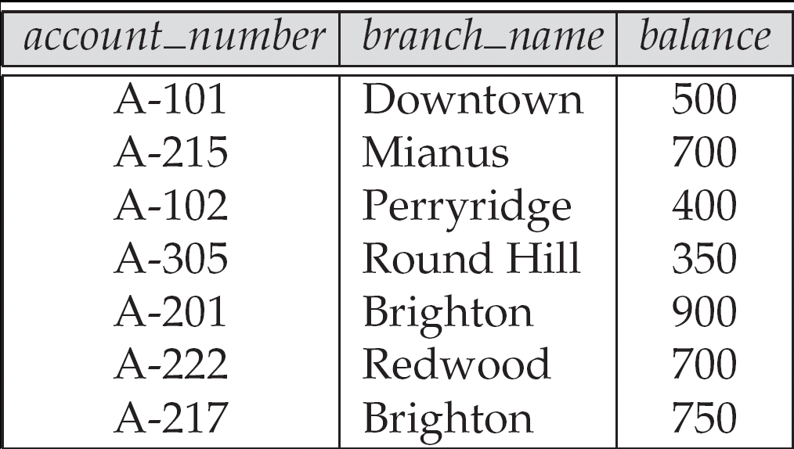
Relations are Unordered
Order of tuples is irrelevant (tuples may be stored in an arbitrary order)
Example: account relation with unordered tuples

Slide 9
Database
A database consists of multiple relations
Information about an enterprise is broken up into parts, with each relation storing one part of the information
account : stores information about accounts
depositor : stores information about which customer
owns which account
customer : stores information about customers
Storing all information as a single relation such as
bank(account_number, balance, customer_name, ..)
results in
  repetition of information (e.g., two customers own an account)
  the need for null values (e.g., represent a customer without an account)
Normalization theory (Chapter 7) deals with how to design relational schemas

Slide 10

The customer Relation

Slide 11

The depositor Relation

Slide 12
Keys
Let K ⊆ R
K is a superkey of R if values for K are sufficient to identify a unique tuple of each possible relation r(R)
  by “possible r ” we mean a relation r that could exist in the enterprise we are modeling.
  Example: {customer_name, customer_street} and
  {customer_name}
  are both superkeys of Customer, if no two customers can possibly have the same name.
K is a candidate key if K is minimal
Example: {customer_name} is a candidate key for Customer, since it is a superkey (assuming no two customers can possibly have the same name), and no subset of it is a superkey.
Primary Key

Slide 13
Query Languages
Language in which user requests information from the database.
Categories of languages
  Procedural
  Non-procedural, or declarative
“Pure” languages:
  Relational algebra
  Tuple relational calculus
  Domain relational calculus
Pure languages form underlying basis of query languages that people use.

Slide 14
Relational Algebra
Procedural language
Six basic operators
  select: σ
  project: ∏
  union: ∪
  set difference: –
  Cartesian product: x
  rename: ρ
The operators take one or two relations as inputs and produce a new relation as a result.

Slide 15
Select Operation – Example
Relation r
A
B
C
D
α
α
β
β
α
β
β
β
1
5
12
23
7
7
3
10
σ_{A=B ^ D > 5} (r)
A
B
C
D
α
β
α
β
1
23
7
10

Slide 16
Select Operation
Notation: σ _{p}(r)
p is called the selection predicate
Defined as:
σ_{p}(r) = {t | t ∈ r and p(t)}
Where p is a formula in propositional calculus consisting of terms connected by : ∧ (and), ∨ (or), ¬ (not)
Each term is one of:
<attribute> op <attribute> or <constant>
where op is one of: =, ≠, >, ≥. <. ≤
Example of selection:
σ _{branch_name=“Perryridge”}(account)

Slide 17
Project Operation – Example
A
B
C
Relation r:
α
α
β
β
10
20
30
40
1
1
1
2
A
C
A
C
∏_{A,C} (r)
α
α
β
β
1
1
1
2
α
β
β
1
1
2
=

Slide 18

Project Operation
Notation:
where A₁, A₂ are attribute names and r is a relation name.
The result is defined as the relation of k columns obtained by erasing the columns that are not listed
Duplicate rows removed from result, since relations are sets
Example: To eliminate the branch_name attribute of account
∏_{account_number, balance} (account)

Slide 19
Union Operation – Example
Relations r, s:
A
B
A
B
α
α
β
1
2
1
α
β
2
3
s
r
A
B
α
α
β
β
1
2
1
3
r ∪ s:

Slide 20
Union Operation
Notation: r ∪ s
Defined as:
r ∪ s = {t | t ∈ r or t ∈ s}
For r ∪ s to be valid.
1. r, s must have the same arity (same number of attributes)
2. The attribute domains must be compatible (example: 2nd column
of r deals with the same type of values as does the 2nd
column of s)
Example: to find all customers with either an account or a loan
∏_{customer_name} (depositor) ∪ ∏_{customer_name} (borrower)

Slide 21
Set Difference Operation – Example
Relations r, s:
A
B
A
B
α
α
β
1
2
1
α
β
2
3
s
r
r – s:
A
B
α
β
1
1

Slide 22
Set Difference Operation
Notation r – s
Defined as:
r – s = {t | t ∈ r and t ∉ s}
Set differences must be taken between compatible relations.
  r and s must have the same arity
  attribute domains of r and s must be compatible

Slide 23
Cartesian-Product Operation – Example
Relations r, s:
A
B
C
D
E
α
β
1
2
α
β
β
γ
10
10
20
10
a
a
b
b
r
s
r x s:
A
B
C
D
E
α
α
α
α
β
β
β
β
1
1
1
1
2
2
2
2
α
β
β
γ
α
β
β
γ
10
10
20
10
10
10
20
10
a
a
b
b
a
a
b
b

Slide 24
Cartesian-Product Operation
Notation r x s
Defined as:
r x s = {t q | t ∈ r and q ∈ s}
Assume that attributes of r(R) and s(S) are disjoint. (That is, R ∩ S = ∅).
If attributes of r(R) and s(S) are not disjoint, then renaming must be used.

Slide 25
Composition of Operations
Can build expressions using multiple operations
Example: σ_{A=C}(r x s)
r x s
σ_{A=C}(r x s)
A
B
C
D
E
α
α
α
α
β
β
β
β
1
1
1
1
2
2
2
2
α
β
β
γ
α
β
β
γ
10
10
20
10
10
10
20
10
a
a
b
b
a
a
b
b
A
B
C
D
E
α
β
β
1
2
2
α
β
β
10
10
20
a
a
b

Slide 26

Rename Operation
Allows us to name, and therefore to refer to, the results of relational-algebra expressions.
Allows us to refer to a relation by more than one name.
Example:
ρ _{x} (E)
returns the expression E under the name X
If a relational-algebra expression E has arity n, then
returns the result of expression E under the name X, and with the
attributes renamed to A₁ , A₂ , …., A_{n} .

Slide 27
Banking Example
branch (branch_name, branch_city, assets)
customer (customer_name, customer_street, customer_city)
account (account_number, branch_name, balance)
loan (loan_number, branch_name, amount)
depositor (customer_name, account_number)
borrower (customer_name, loan_number)

Slide 28
Example Queries
Find all loans of over $1200
σ_{amount > 1200} (loan)
Find the loan number for each loan of an amount greater than $1200
∏_{loan_number} (σ_{amount} _{> 1200} (loan))

Slide 29
Example Queries
Find the names of all customers who have a loan, an account, or both, from the bank
  ∏_{customer_name} (borrower) ∪ ∏_{customer_name} (depositor)
Find the names of all customers who have a loan and an account at bank.
  ∏_{customer_name} (borrower) ∩ ∏_{customer_name} (depositor)

Slide 30
Example Queries
Find the names of all customers who have a loan at the Perryridge branch.
∏_{customer_name} (σ_{branch_name=“Perryridge”}
(σborrower.loan_number = loan.loan_number(borrower x loan)))
Find the names of all customers who have a loan at the
Perryridge branch but do not have an account at any branch of
the bank.
∏_{customer_name} (σ_{branch_name = “Perryridge”}
(σborrower.loan_number = loan.loan_number(borrower x loan))) –
∏_{customer_name}(depositor)

Slide 31
Example Queries
Find the names of all customers who have a loan at the Perryridge branch.
  Query 1
  ∏_{customer_name} (σ_{branch_name = “Perryridge”} (
  σborrower.loan_number = loan.loan_number (borrower x loan)))
  Query 2
  ∏_{customer_name}(σloan.loan_number = borrower.loan_number (
  (σ_{branch_name = “Perryridge”} (loan)) x borrower))

Slide 32
Example Queries
Find the largest account balance
  Strategy:
    Find those balances that are not the largest
      Rename account relation as d so that we can compare each account balance with all others
    Use set difference to find those account balances that were not found in the earlier step.
  The query is:
∏_{balance}(account) - ∏_{account.balance}
(σ_{account.balance < d.balance} (account x ρ_{d} (account)))

Slide 33
Additional Operations
We define additional operations that do not add any power to the
relational algebra, but that simplify common queries.
Set intersection
Natural join
Division
Assignment

Slide 34
Natural-Join Operation
Notation: r s
Let r and s be relations on schemas R and S respectively.
Then, r s is a relation on schema R ∪ S obtained as follows:
  Consider each pair of tuples t_{r} from r and t_{s} from s.
  If t_{r} and t_{s} have the same value on each of the attributes in R ∩ S, add a tuple t to the result, where
    t has the same value as t_{r} on r
    t has the same value as t_{s} on s
Example:
  R = (A, B, C, D)
  S = (E, B, D)
  Result schema = (A, B, C, D, E)
  r s is defined as:
  ∏_{r.A, r.B, r.C, r.D, s.E} (σ_{r.B = s.B} ∧ _{r.D = s.D} (r x s))

Slide 35
Natural Join Operation – Example
Relations r, s:
A
B
C
D
B
D
E
α
β
γ
α
δ
1
2
4
1
2
α
γ
β
γ
β
a
a
b
a
b
1
3
1
2
3
a
a
a
b
b
α
β
γ
δ
∈
r
s
r s
A
B
C
D
E
α
α
α
α
δ
1
1
1
1
2
α
α
γ
γ
β
a
a
a
a
b
α
γ
α
γ
δ

Slide 36
Bank Example Queries
Find the names of all customers who have a loan and an account at bank.
  ∏_{customer_name} (borrower) ∩ ∏_{customer_name} (depositor)
Find the name of all customers who have a loan at the bank and the loan amount

Slide 37
Bank Example Queries
Find all customers who have an account from at least the “Downtown” and the Uptown” branches.
  Query 1
    ∏_{customer_name} (σ_{branch_name = “Downtown”} (depositor account )) ∩
    ∏_{customer_name} (σ_{branch_name = “Uptown”} (depositor account))
  Query 2
  ∏_{customer_name, branch_name} (depositor account)
  ÷ ρ_{temp(branch_name)} ({(“Downtown” ), (“Uptown” )})
  Note that Query 2 uses a constant relation.

Slide 38
Example Queries
Find all customers who have an account at all branches located in Brooklyn city.
∏_{customer_name, branch_name} (depositor account)
÷ ∏_{branch_name} (σ_{branch_city = “Brooklyn”} (branch))

Slide 39
Extended Relational-Algebra-Operations
Generalized Projection
Aggregate Functions
Outer Join

Slide 40

Aggregate Functions and Operations
Aggregation function takes a collection of values and returns a single value as a result.
avg: average value
min: minimum value
max: maximum value
sum: sum of values
count: number of values
Aggregate operation in relational algebra
E is any relational-algebra expression
  G₁, G₂ …, G_{n} is a list of attributes on which to group (can be empty)
  Each F_{i} is an aggregate function
  Each A_{i} is an attribute name

Slide 41
Aggregate Operation – Example
Relation r:
A
B
C
α
α
β
β
α
β
β
β
7
7
3
10
g _{sum(c)} (r)
sum(c )
27

Slide 42
Aggregate Operation – Example
Relation account grouped by branch-name:
branch_name
account_number
balance
Perryridge
Perryridge
Brighton
Brighton
Redwood
A-102
A-201
A-217
A-215
A-222
400
900
750
750
700
_{branch_name} g _{sum(balance)} (account)
branch_name
sum(balance)
Perryridge
Brighton
Redwood
1300
1500
700

Slide 43
Aggregate Functions (Cont.)
Result of aggregation does not have a name
  Can use rename operation to give it a name
  For convenience, we permit renaming as part of aggregate operation
_{branch_name} g _{sum(balance) as sum_balance} (account)

Slide 44
Outer Join
An extension of the join operation that avoids loss of information.
Computes the join and then adds tuples form one relation that does not match tuples in the other relation to the result of the join.
Uses null values:
  null signifies that the value is unknown or does not exist
  All comparisons involving null are (roughly speaking) false by definition.
    We shall study precise meaning of comparisons with nulls later

Slide 45
Outer Join – Example
Relation loan
loan_number
branch_name
amount
L-170
L-230
L-260
Downtown
Redwood
Perryridge
3000
4000
1700
Relation borrower
customer_name
loan_number
Jones
Smith
Hayes
L-170
L-230
L-155

Slide 46
Outer Join – Example
Inner Join
loan Borrower
loan_number
branch_name
amount
customer_name
L-170
L-230
Downtown
Redwood
3000
4000
Jones
Smith
Left Outer Join
loan Borrower
loan_number
branch_name
amount
customer_name
L-170
L-230
L-260
Downtown
Redwood
Perryridge
3000
4000
1700
Jones
Smith
null

Slide 47
Outer Join – Example
Right Outer Join
loan borrower
loan_number
branch_name
amount
customer_name
L-170
L-230
L-155
Downtown
Redwood
null
3000
4000
null
Jones
Smith
Hayes
Full Outer Join
loan borrower
loan_number
branch_name
amount
customer_name
L-170
L-230
L-260
L-155
Downtown
Redwood
Perryridge
null
3000
4000
1700
null
Jones
Smith
null
Hayes

Slide 48
Modification of the Database
The content of the database may be modified using the following operations:
  Deletion
  Insertion
  Updating
All these operations are expressed using the assignment operator.

Slide 49
End of Chapter 2

Slide 50
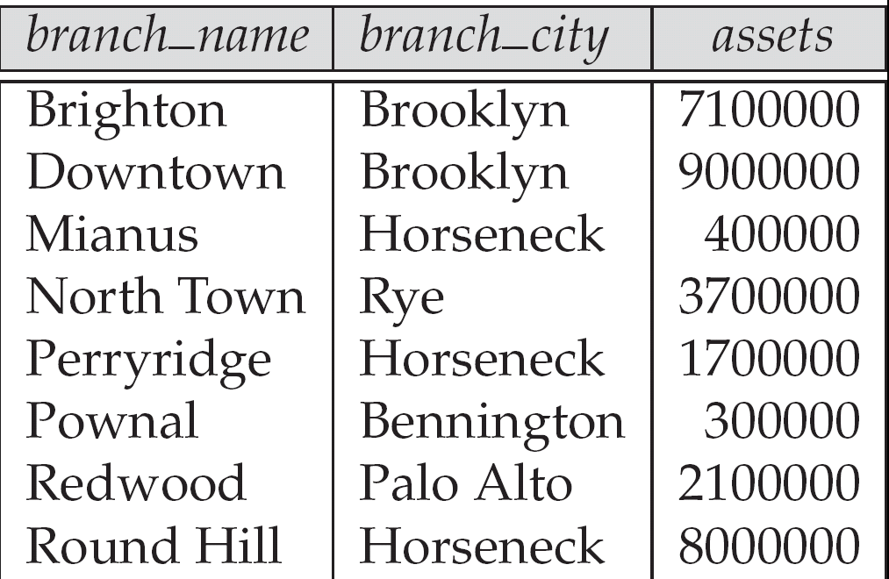
Figure 2.3. The branch relation

Slide 51

Figure 2.6: The loan relation

Slide 52
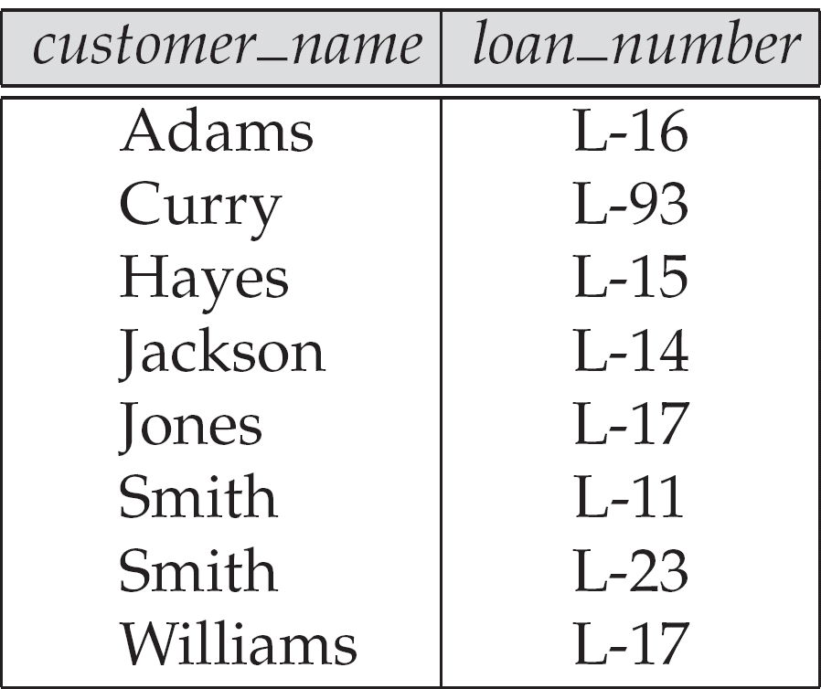
Figure 2.7: The borrower relation

Slide 53

Figure 2.8: Schema diagram

Slide 54
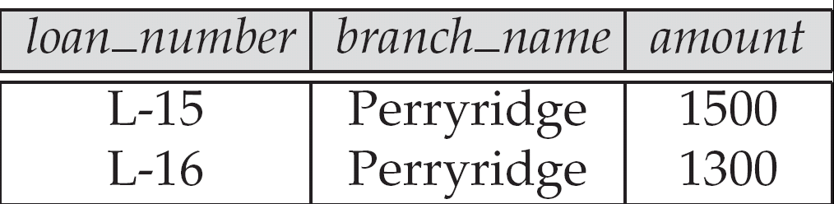
Figure 2.9
Result of σ_{branch_name = “Perryridge”} (loan)

Slide 55
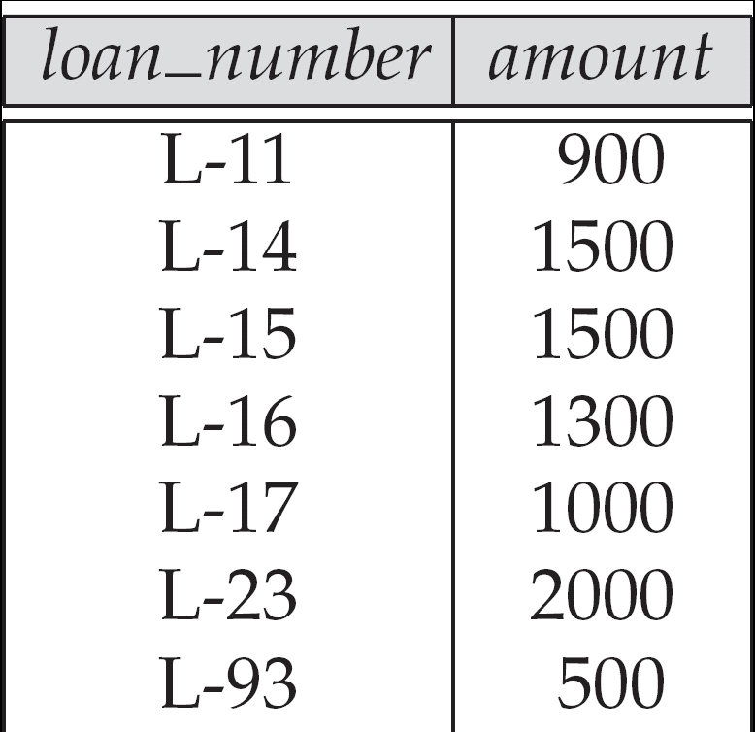
Figure 2.10:
Loan number and the amount of the loan

Slide 56
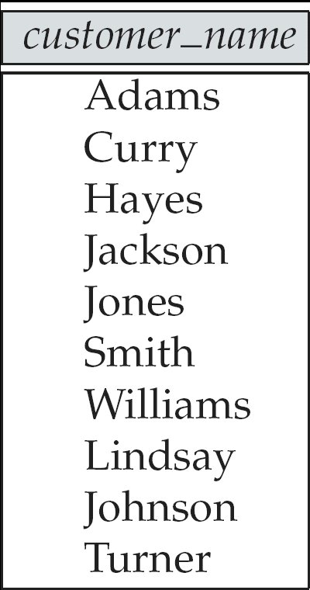
Figure 2.11: Names of all customers who have either an account or an loan

Slide 57
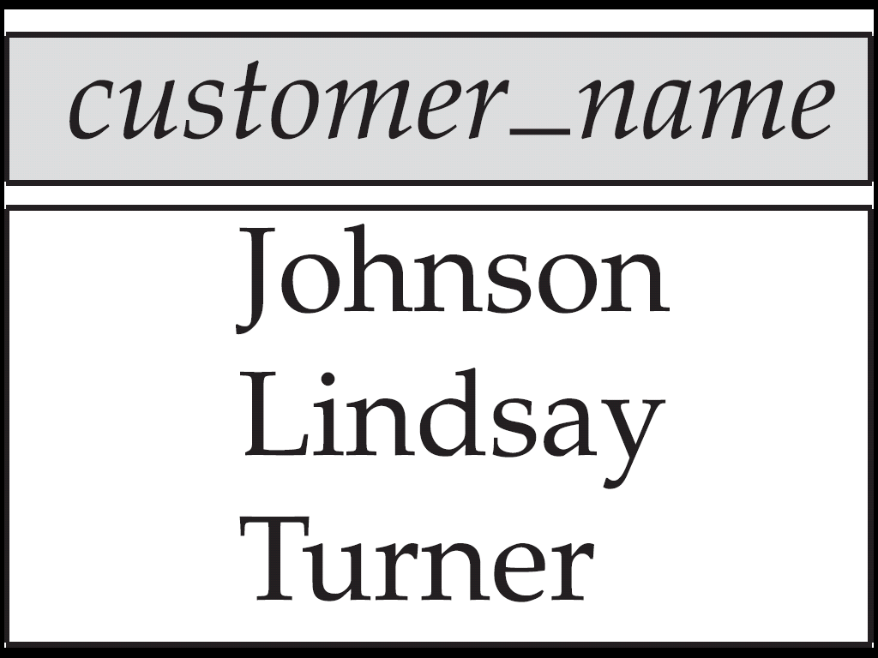
Figure 2.12:
Customers with an account but no loan

Slide 58
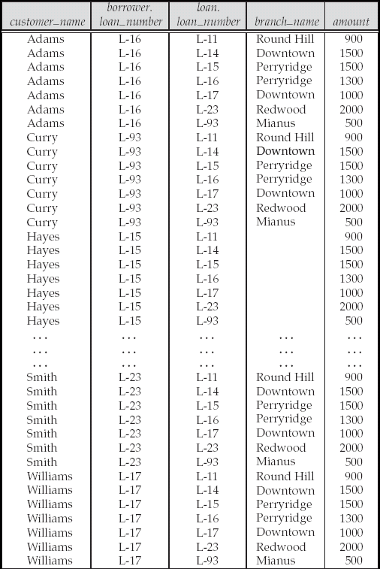
Figure 2.13: Result of borrower |X| loan

Slide 59
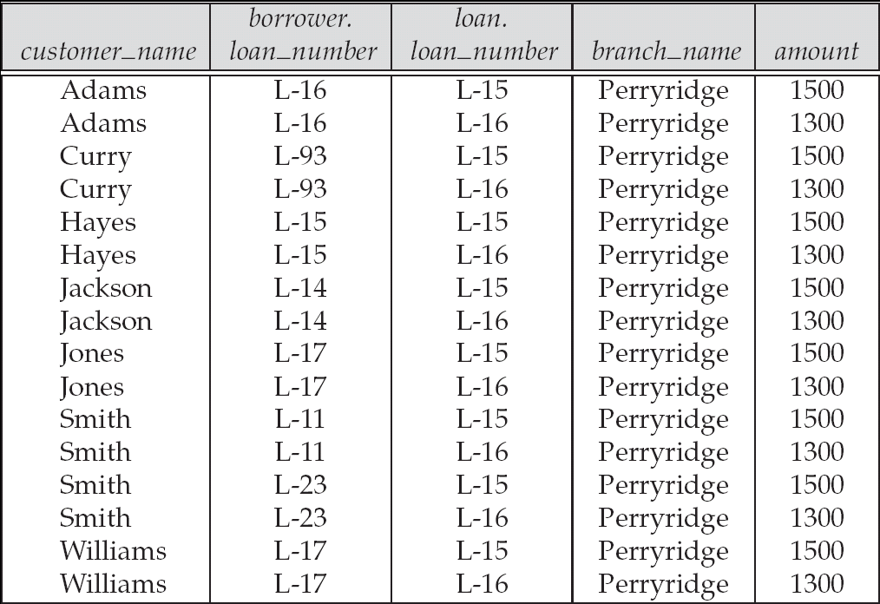
Figure 2.14

Slide 60
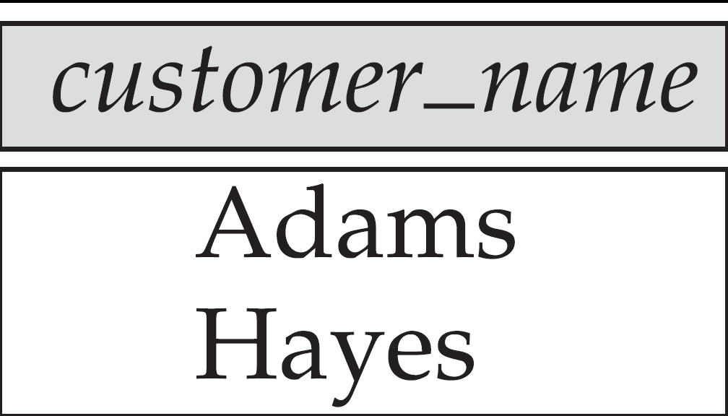
Figure 2.15

Slide 61
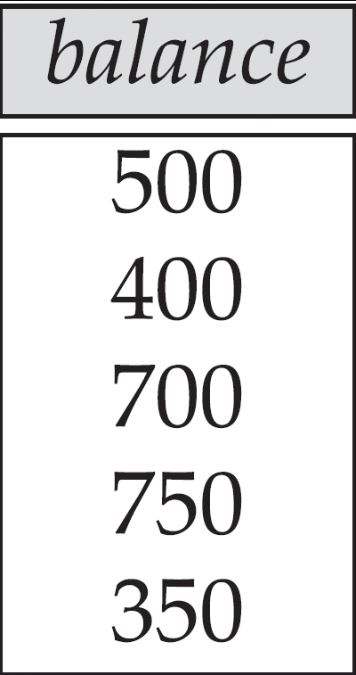
Figure 2.16

Slide 62
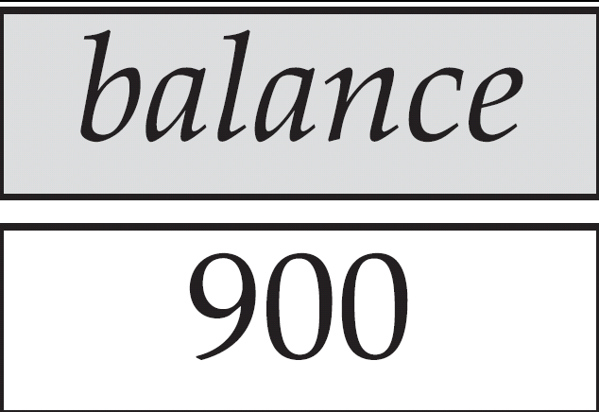
Figure 2.17
Largest account balance in the bank

Slide 63
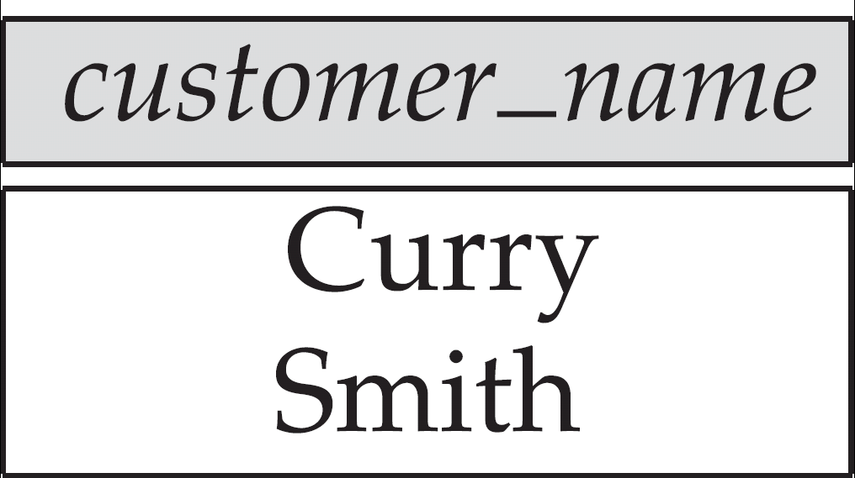
Figure 2.18: Customers who live on the same street and in the same city as Smith

Slide 64
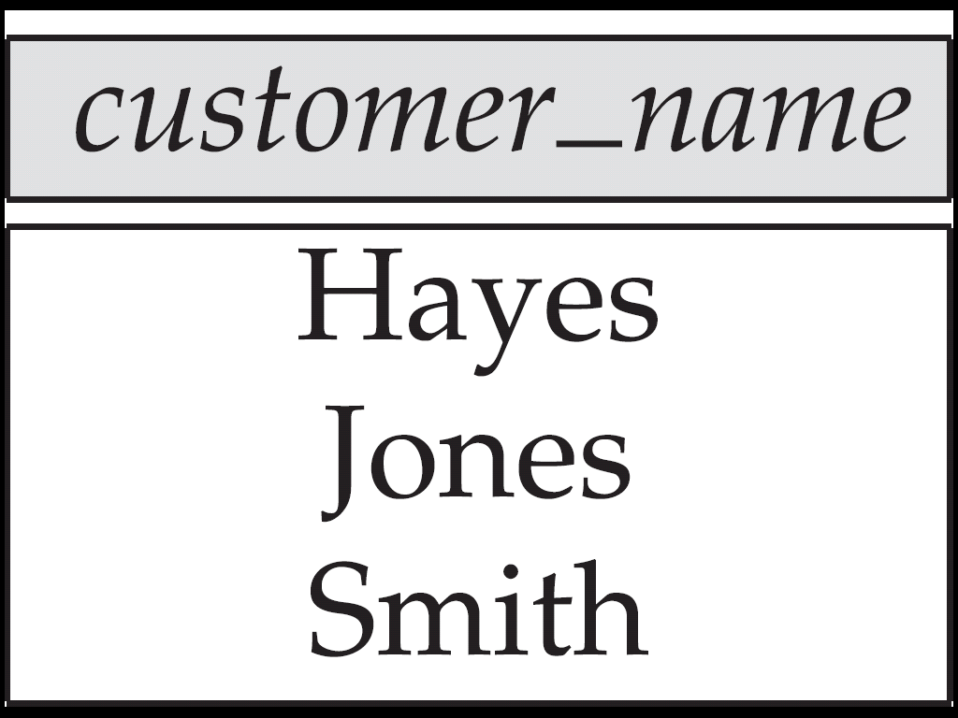
Figure 2.19: Customers with both an account and a loan at the bank

Slide 65
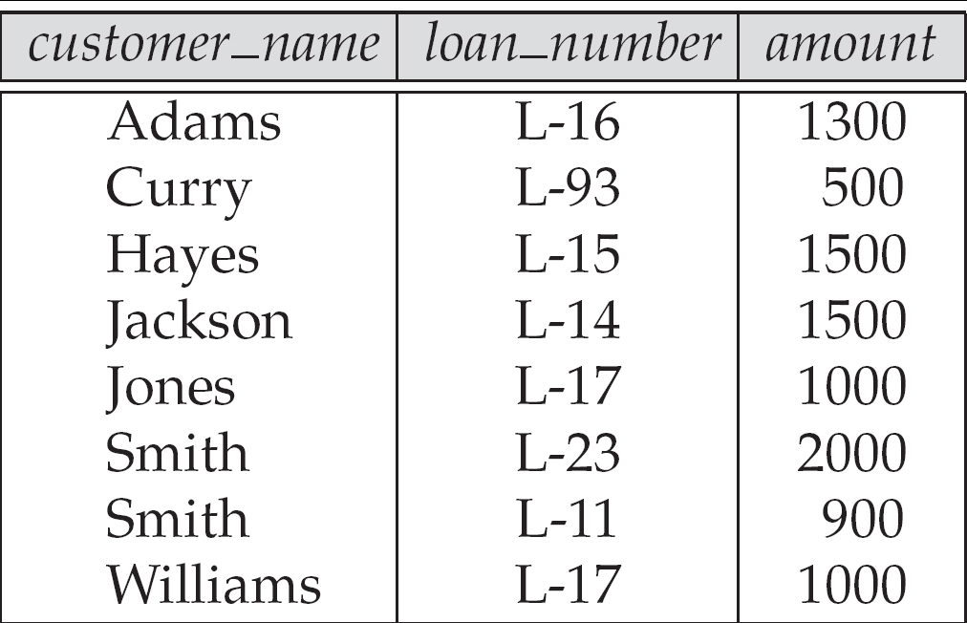
Figure 2.20

Slide 66
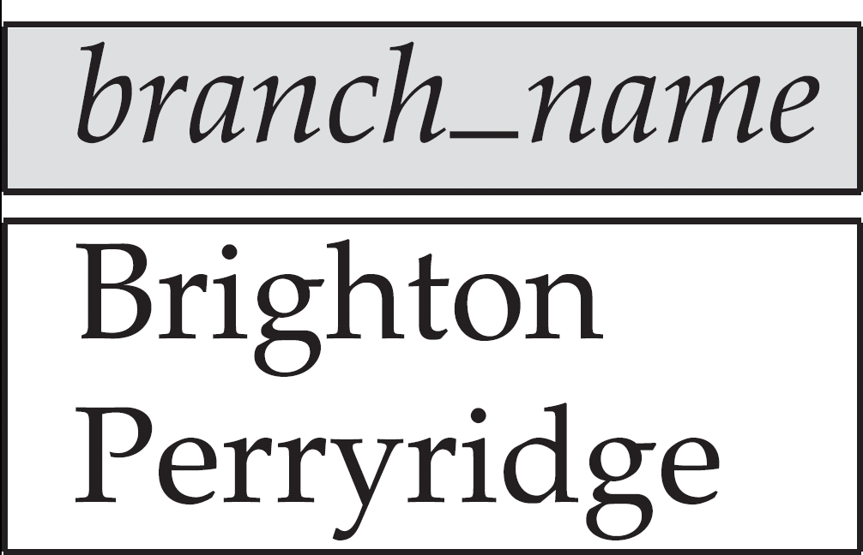
Figure 2.21

Slide 67
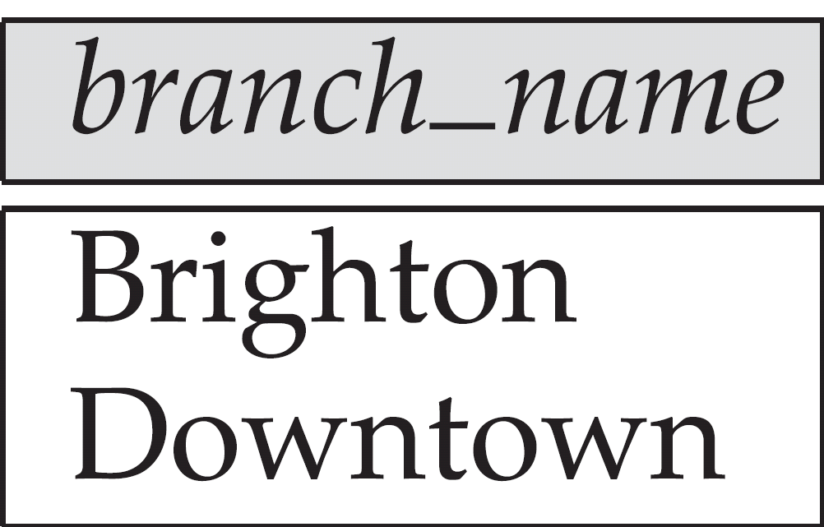
Figure 2.22

Slide 68
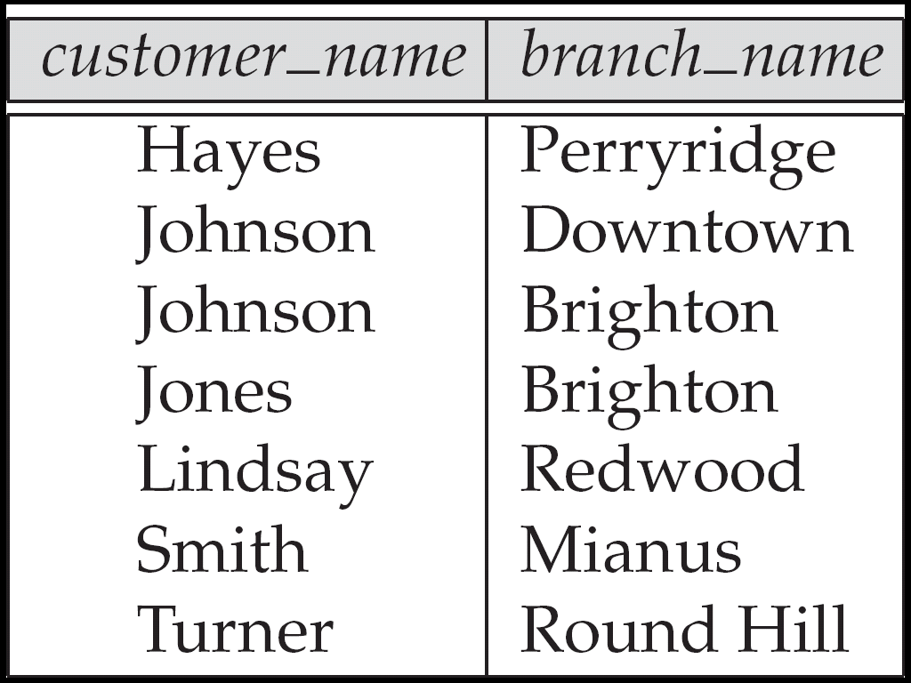
Figure 2.23

Slide 69
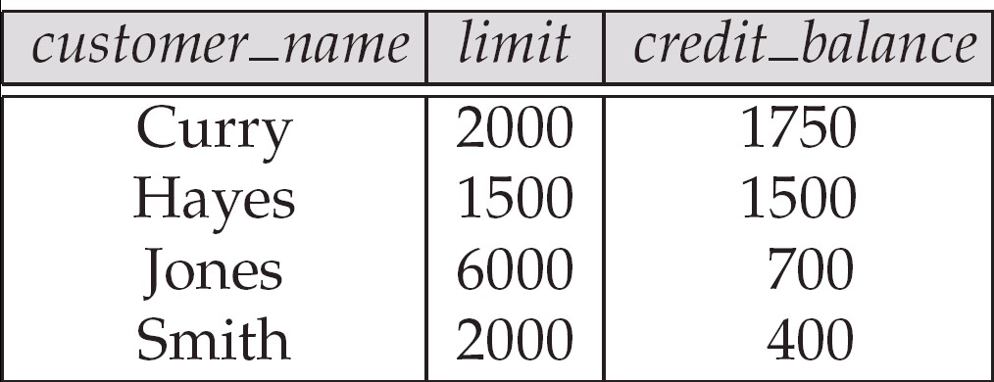
Figure 2.24: The credit_info relation

Slide 70
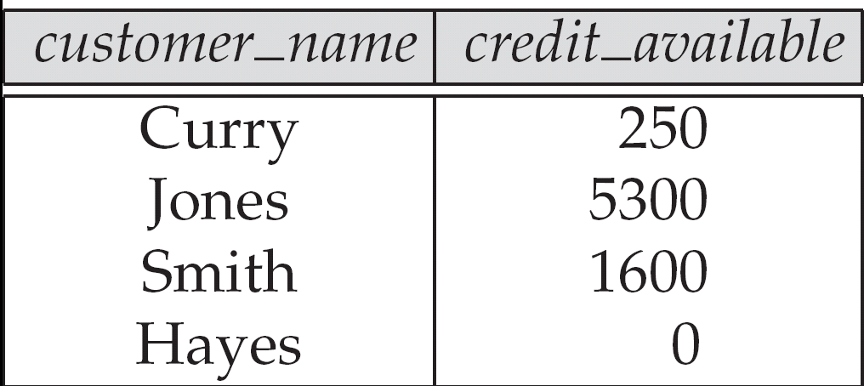
Figure 2.25

Slide 71
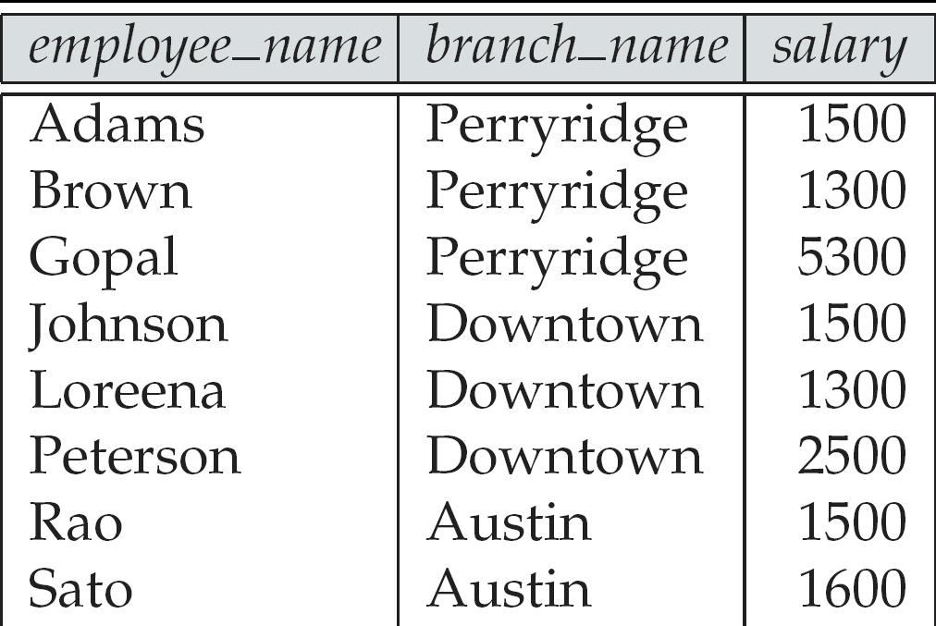
Figure 2.26: The pt_works relation

Slide 72
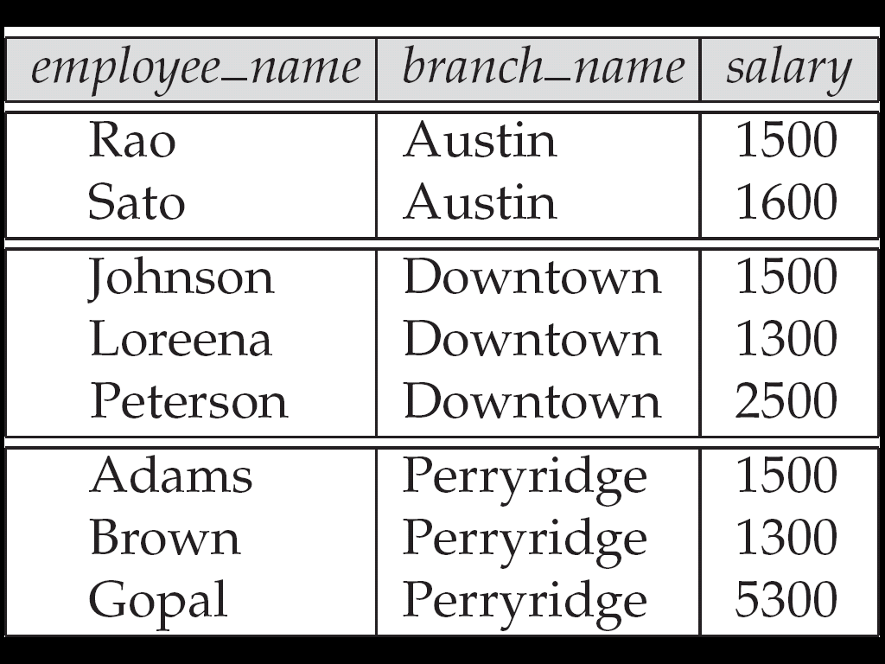
Figure 2.27
The pt_works relation after regrouping

Slide 73
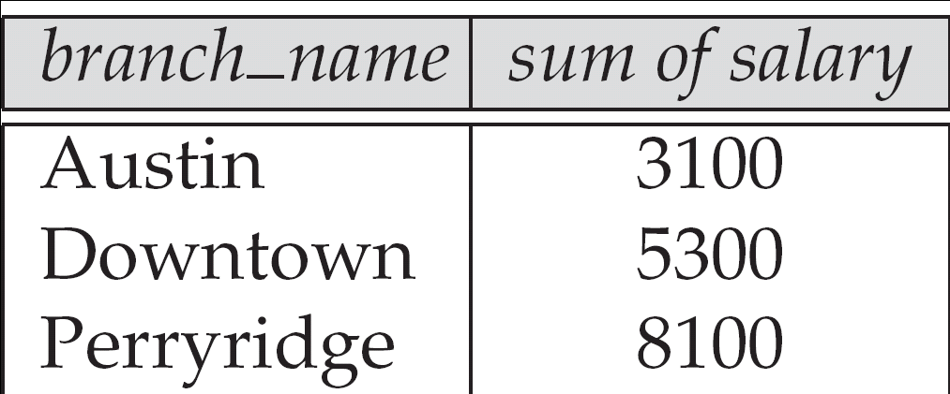
Figure 2.28

Slide 74
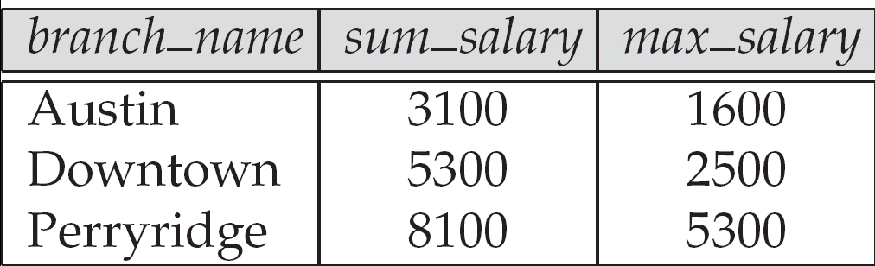
Figure 2.29

Slide 75
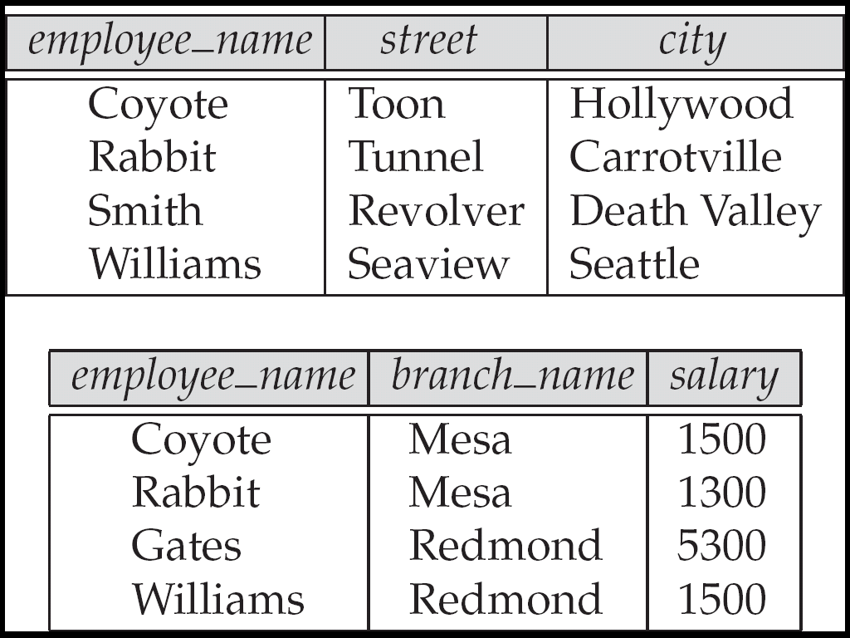
Figure 2.30
The employee and ft_works relations

Slide 76
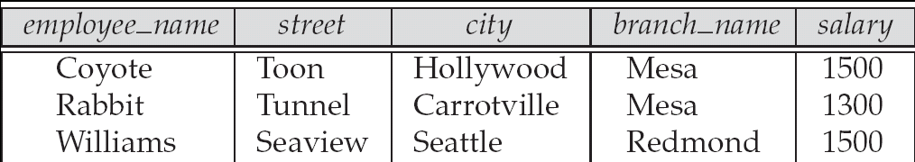
Figure 2.31

Slide 77
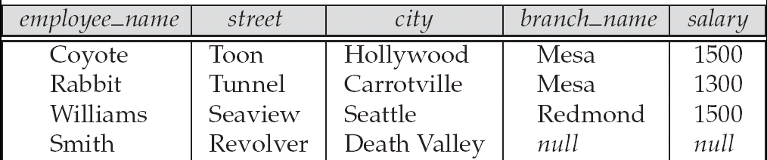
Figure 2.32

Slide 78
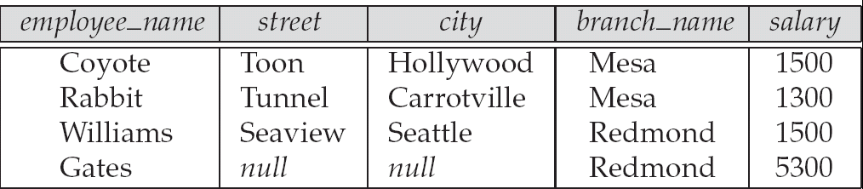
Figure 2.33

Slide 79
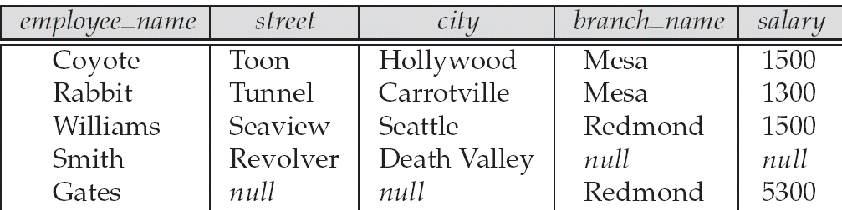
Figure 2.34

